Slide 1
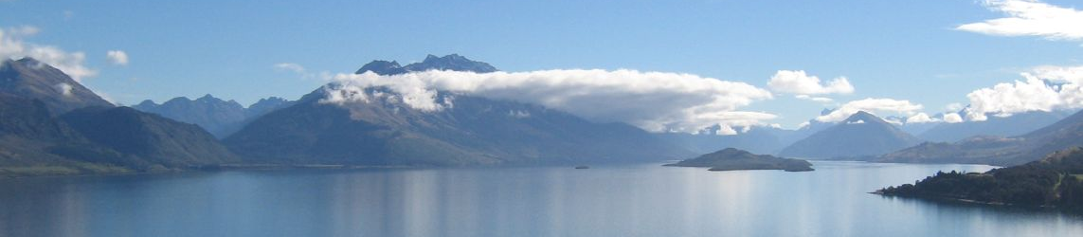

One Year on – The Sale and Supply of Alcohol Act 2012
Queenstown Lakes District Council

Slide 2
New Beginning's
  A Local Alcohol Policy
  National standardisation and consistency of enforcement
  Collaboration
  S131
  S106 Amenity and Good Order

Slide 3
Eureka Moments!
Media attention
Intoxication definition
Matters can be dealt with in a timely manner.
Electronic filing of correspondence is crucial.
Implementation of a new special licence form.
The Intoxication assessment tool
Reduced drink driving levels are timely with the introduction of the new Act.

Slide 4
Key Challenges
Workloads
Staff resourcing for all agencies involved.
District Licensing Committee decisions

Slide 5
Priorities
Increased monitoring
Maintain the current pressure on licensee’s regarding their responsibilities for food.
Education and evidence

Slide 6
Queenstown Dynamics
High number of special licence applications
Seasonal staff turnover.
Growth projections for Queenstown are naturally attractive to new businesses.

Slide 7
Key Leanings
Vinyl Underground.
If you don’t ask you don’t get
Special licences for significant international sporting events.

Slide 8
Moving Forward….
HPA’s assistance with a standardised educational kit to run Drink Safe workshops would be invaluable.
Nationally more dialogue and education between all sectors
Advertising campaigns
Staff resourcing.

Slide 9

Questions?

