Slide 1
One Year On
SSAA 2012
A Medical Officer of Health view
Dr Stephen Palmer
March 2015

Slide 2
Topics
Your thoughts on the capacity of the SSAA 2012 and its potential to achieve the new Object and to deliver on government intentions
What successes, positive impacts, and emerging best practice examples have you seen so far?
What have been the key challenges/limitations during the first year of implementation and why do you think this?
What would be your top 3 priorities/ideas for the sector to improve outcomes, achieve better implementation and minimise harm?

Slide 3
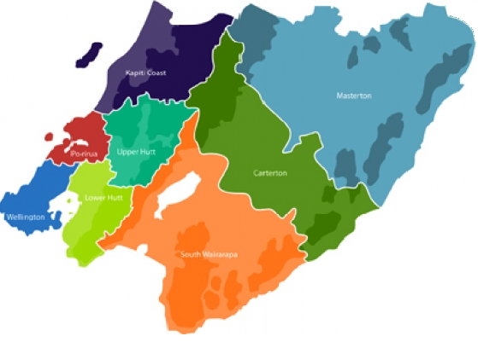

Key Challenges/limitations
8x TAs =>
  8x DLCs
  8x Licensing Inspectors
  8x poor understanding of PH
  8x complexity
  5x LAPs ?????
∆ PH Focus =>
  Supermarkets & Liquor stores
  Vulnerable communities
  Less on host responsibility
Old systems not fit for purpose:
  Massive increase in workload
  More oppositions & hearings
  Extremely short time frames
Clash of PARADIGMs
Confusion over amenity & good order

Slide 4



Positive Impacts
DLCs are in tune with local alcohol issues:
  Wellington
  Masterton
  Porirua
  Kapiti
Involvement of communities
Closer work with Police
School fairs
  Still some non- accepters

Slide 5
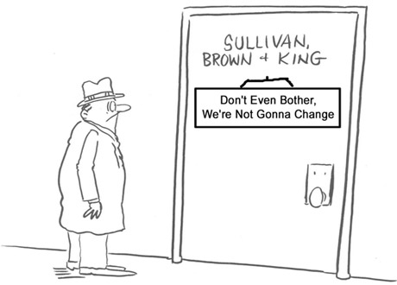
Capacity/potential to achieve
Object of Act & government intentions
Only one strategy in Five + One
Good purpose & object
LAPs have potential
Agency collaboration
But potentiates status quo
No performance expectation around DLCs and ARLA
National default hours not enough

Slide 6


Top 3 Priorities
Bridge the paradigm gap
  Will require bilateral movement
Greater commitment to achieve
Object of the Act
  Performance targets for
  inspectors, DLCs and ARLA:
    Alcohol-related harm
    Number & density of licences
  Look beyond injury prevention to:
    NCDs (?????)
    Indirect harm & harm to communities
Greater emphasis on community involvement:
  Perception of:
    Barriers
    Not being listened to

Slide 7


